Slide 1

Mambu Training Manual
april 2022

Slide 2
V. Mambu Process Orchestrator

Slide 3




V. Mambu Process Orchestrator
MPO Overview
At the heart of the Mambu platform is a cloud-native engine that, in combination with a coordinating orchestration layer and our APIs, can connect with the features and functions you need to bring your financial offering to life.
Mambu Process Orchestrator
To create great experiences for your customers, you need to integrated with best-for-purpose technologies. Mambu’s Process Orchestrator is an API-driven alternative to traditional business process management tools. Our orchestrator is central command for bespoke business logic, integration management and process design. The orchestrator coordinates and integrates all individual components – whether with partner platforms or other specific features you need – and connects them with your engine.
Build Faster
An intuitive no-code/low-code interface to design, build and maintain holistic API-driven business processes in a visual development environment.
Integrate Faster
Using RESTful APIs and a rapid implementation approach so you aren’t developing or maintaining code every time you integrate.
Scale Faster
Debug, monitor, report, handle errors and retry mechanisms on all processes for a single view of integration issues.
Change Faster
Replace the time and effort it takes to re-deploy code when business processes change.

Slide 4
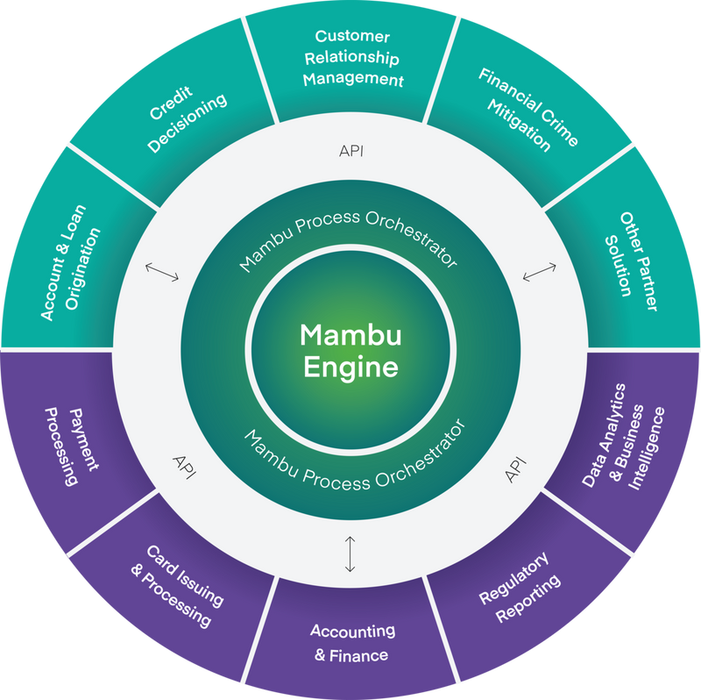
V. Mambu Process Orchestrator
MPO Overview
How MPO fits into the Mambu ecosystem ?
In Mambu’s composable banking architecture, MPO offers a low-code way to tie together different SaaS and in-house applications to create products and features for your clients or to meet your regulatory obligations.
The following diagram illustrates the architecture of a typical integration with Mambu banking.
MPO works well with Mambu Banking Engine to facilitate process interaction between components, and it can be used to enhance Mambu’s functionality by adding custom logic on top of the Mambu API.
The MPO as part of your composable architecture.
Connected products and services:
Web
Card issuing
Customer service
Mobile
CRM
Identify verification
Onboarding

Slide 5
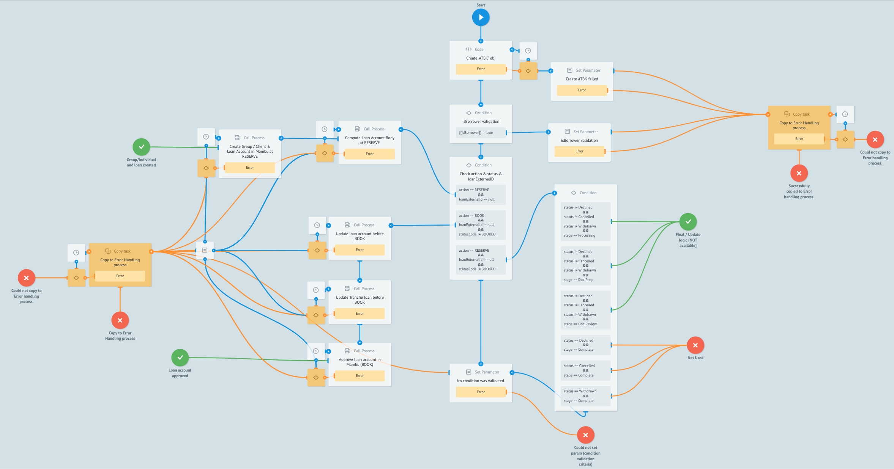
V. Mambu Process Orchestrator
MPO Overview
Using the drag-and-drop user interface, you can create, debug, and run processes – as well as access reports and statistics via customizable dashboards. MPO provides robust synchronous and asynchronous APIs to run and manage workflows or integrate into your existing CI/CD pipelines.
Note that MPO does not require Mambu in order to run and may be used completely independently of Mambu as a standalone process orchestrator for any suitable application.

Slide 6
V. Mambu Process Orchestrator
Some questions about MPO
What is MPO?
Mambu Process Orchestrator (MPO) is an enterprise package which acts as a middle layer between different systems to pull, process and push data via APIs. The system uses a graphical interface similar to Business Process Model and Notation (BPMN) graphing to model, create and execute processes and workflows that run in the cloud.
Where is MPO located ?
As a cloud-based service, MPO is collocated with your Mambu instance to allow for fast data transfer with the Mambu Core Banking Engine. Processes are run across multiple availability zones, and data is transparently synchronized to a second availability zone, providing active failover in case of unexpected system outages. The service comes with a sandbox environment for testing your processes and workflows in a non-production environment.
How to get MPO?
Mambu Process Orchestrator is an optional add-on. Speak to your delivery consultant or customer service manager to discuss your needs and set up a demonstration of the MPO.
How to access MPO?
When your MPO instance is created you will have an administrator account created for you. To log in, simply go to your MPO instance at your given URL and sign in with your email and password.

Slide 7
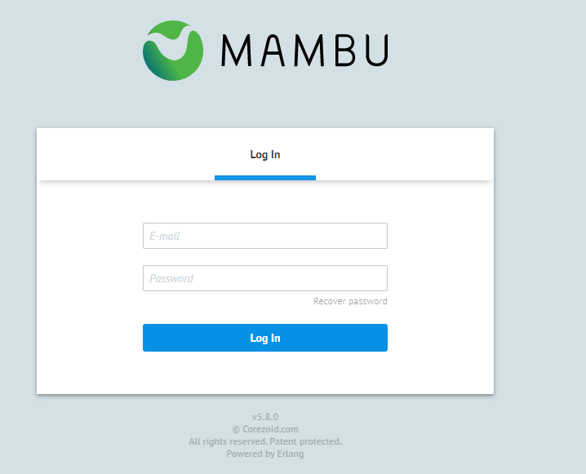
V. Mambu Process Orchestrator
MPO Overview: Log in
To access the MPO, use the link Mambu Process Orchestrator. It will show the form below:
Enter your Deloitte e-mail and Password
Click at Login button
Note: The first time you log in, the email is that of the company and the password of the Mambu sandbox.

Slide 8
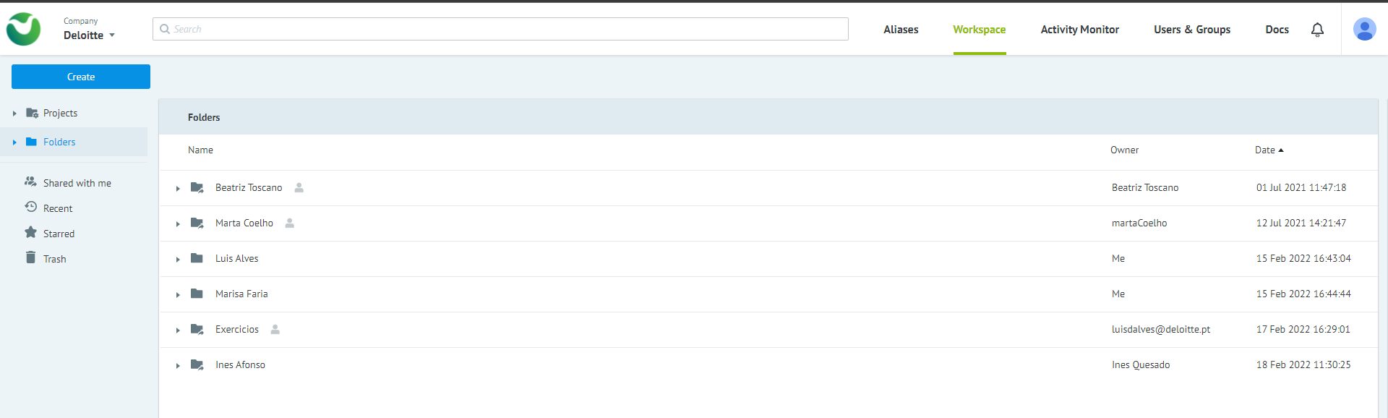
V. Mambu Process Orchestrator
MPO Overview: Structure
After logging in, the following structure is displayed:
1
2
3
4
5
Aliases: Type of MPO object which allows replacing the numerical process identifier with a human-readable name.
Workspace: The main working environment for process navigation.
Activity Monitor: Find statistics of computational resources that are consumed by the processes.
Users & Groups: Place to manage process access rights.
Profile: Contains information about user profile.

Slide 9
V. Mambu Process Orchestrator
MPO Overview: Structure
After logging in, the following structure is displayed:
This area is public, for all team members.
Note: It is recommended that you create a folder with your name and organize all your files within your folder.
Folder Owner
Creation folder date

Slide 10
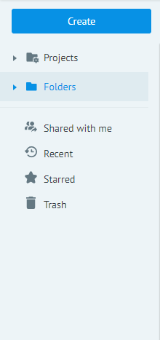
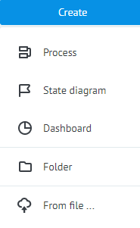
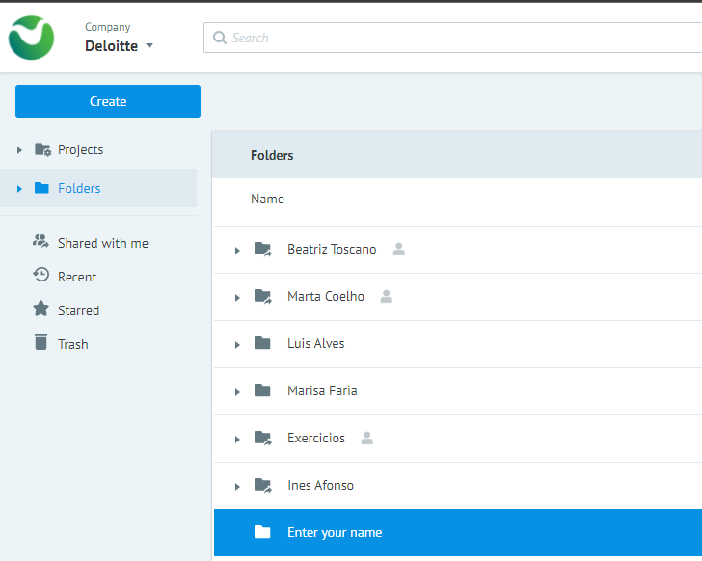
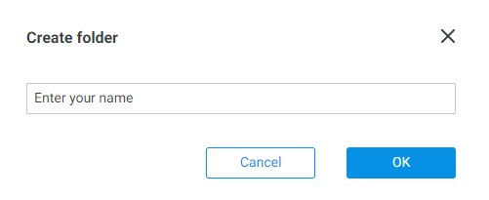
V. Mambu Process Orchestrator
MPO Overview: Create a Folder
To create a folder, it is necessary to select Folders and then click on the Create button. A dropdown list will appear, and you will have to select Folder. In the Create folder preview window, enter the desired name for the folder and click OK.
Enter your name and click OK.
Note: In order to keep the folders organized, each team element has a folder with its name.

Slide 11
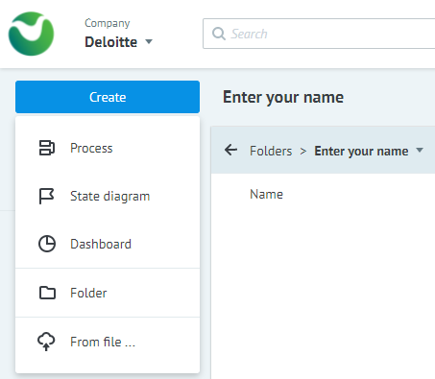
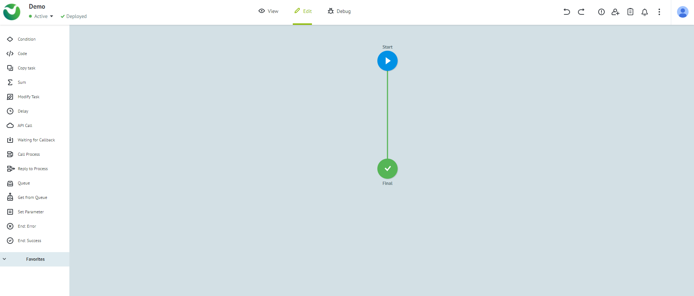
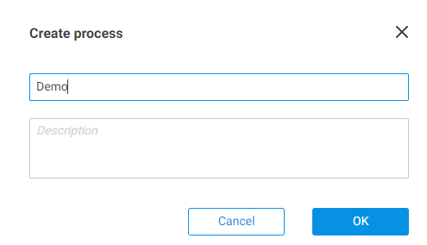
V. Mambu Process Orchestrator
MPO Overview: Create a Process
Inside the created folder, click on the Create button. A dropdown list will appear, and you will have to select Process. In the Create process preview window, enter the desired name for the process and click OK.
Note: It is recommended to create the process inside your personal folder.

Slide 12
V. Mambu Process Orchestrator
MPO Overview: Details of Process
After creating a project, a new window will appear with the process created. A Start node is displayed on the workspace.
The Edit mode window contains a large central pane, which is the canvas for our new process, as well as a menu bar across the top and node logic pane along the left-hand side. The Start and Final nodes of the process are created automatically.
It is recommended that every process begins with a Start node and for every outcome to conclude with a Final node to avoid creating infinite loops.
If the example process below were to run in its current state, the task would be passed from Start to Final without any changes or redirection and without triggering any additional actions. To build out the process, we’ll need to add nodes.
Demo (Name of the process)
Edit mode
Start Node

Slide 13
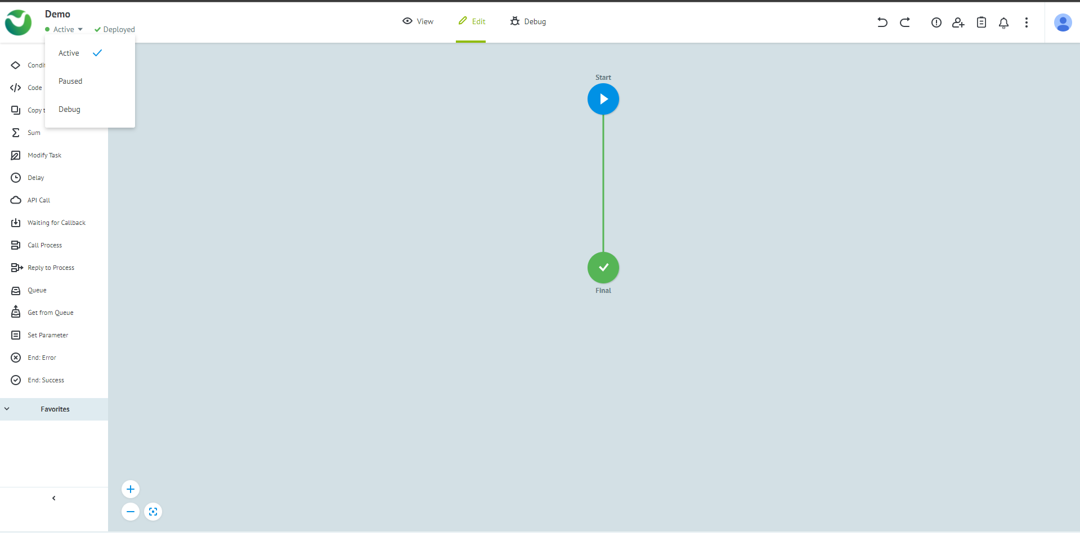
V. Mambu Process Orchestrator
MPO Structure: Menu Bar
The menu bar contains three groups of buttons:
On the left side of the screen, under a dropdown menu, you can control the state of the process: Active, Paused, Debug or Blocked.
The button next to the dropdown allows you to deploy the process and save your work.
In the center of the screen, you can switch between the three modes: View mode, Edit mode, and Debug mode.
State of the process
Deploy the process
Mode

Slide 14
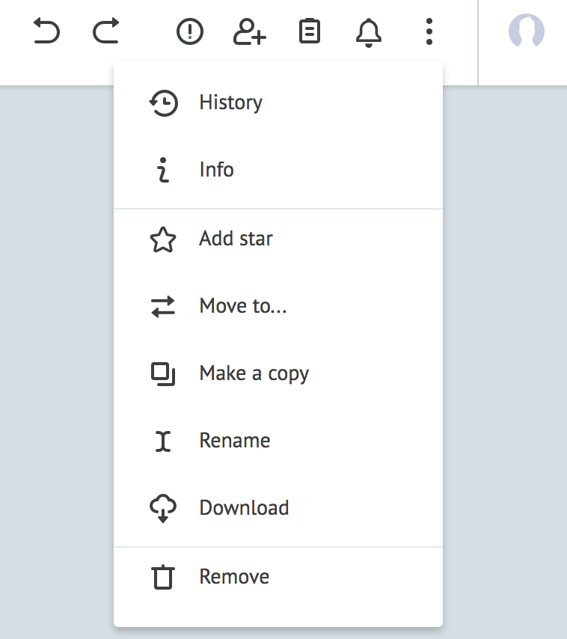
V. Mambu Process Orchestrator
MPO Structure: Menu Bar
On the right side, from left to right, you can:
Undo and redo the 20 most recent actions.
View error descriptions of errors within your process.
Share your process.
Edit task parameters, where you can add variables that will be used in the process as key-value pairs - {{key}} : value.
View notifications.
The following additional options are available via the three-dots menu: History, Info, Add star, Move to…, Make a copy, Rename, Download and Remove.
Finally, you can click the user icon in the upper, right-hand corner to view more information about your MPO account.
Note: The actions in the three-dots menu apply to the whole process and not individual nodes: Rename will rename the whole process.

Slide 15
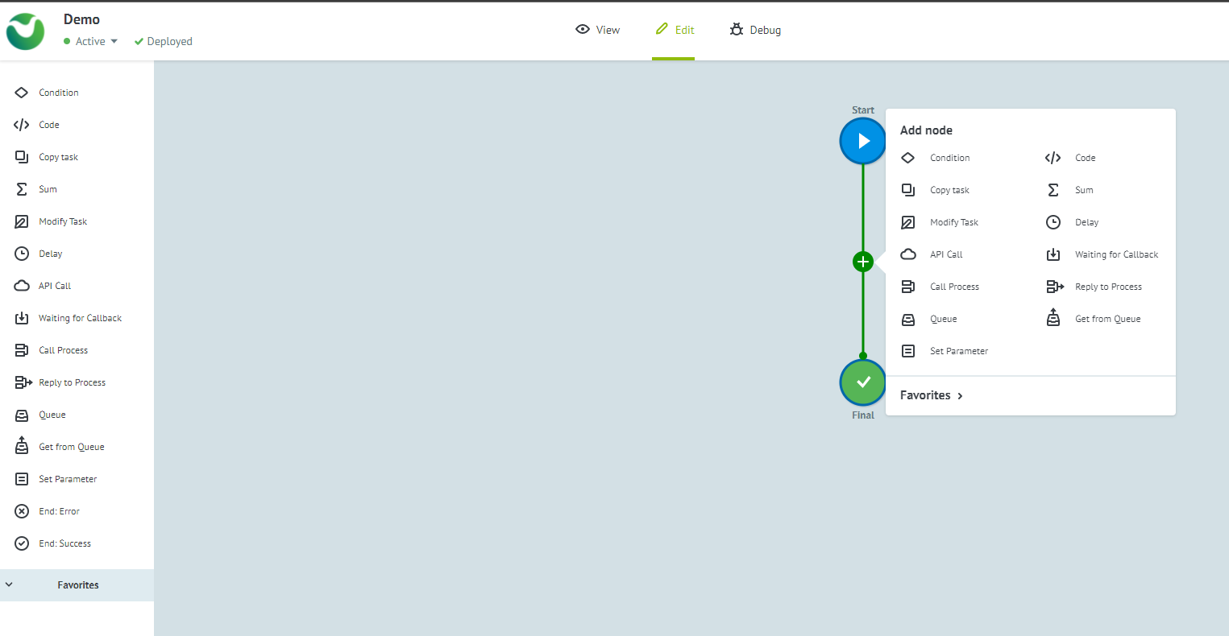
V. Mambu Process Orchestrator
MPO Structure: Node Logic Pane
The Nodes Pane allows you to add actions to your process. Nodes are units of logic that help you build your process. For descriptions of each node type, please see Node Basics.
A process may be as simple as one condition or be as complex as a process with hundreds of nodes.
There are two methods to add a node to a process:
Drag and drop the node from the Node Logic pane to a blank space on the canvas or over a green line to add it between other nodes.
Clicking the plus icon (+) on the connector between two nodes.
Node Logic Pane

Slide 16
V. Mambu Process Orchestrator
MPO Structure: Node Logic Pane
Every Corezoid process is made of nodes and every node contains its unique logic. Tasks move through the process from node to node, following specified logic.
Node Logic Name | Description | Details
Condition | Going by the condition. Possible conditions =, !=, <, >, regex | Link
Code | Possibility to realize an additional task processing logic with one of the languages (JavaScript, Erlang) | Link
Copy task | Copy task in a different process | Link
Sum | Sum of the amount by a certain task filed | Link
Modify task | Updating task in a different process | Link
Delay | Time interval (delay), at which task will go further through the process, also specified critical amount of tasks in node - task limit | Link
API Call | External API call with parameters | Link
Waiting for Callback | Waiting for reply by request from external system | Link
Call Process | Call unique process | Link
Reply to Process | Reply to universal process call | Link
Queue | Implementation of queue logic | Link
Get from Queue | Received tasks from the queue | Link
Set Parameter | Set the parameter / modifying parameters value in the task | Link
End: Error | End node that contains tasks with process errors | Link
End: Success | End node that contains successful process tasks | Link

Slide 17
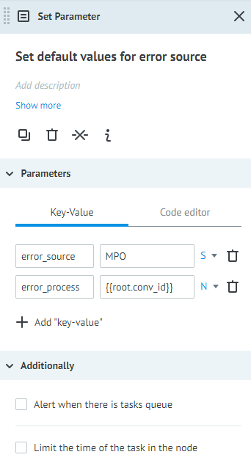
V. Mambu Process Orchestrator
MPO Structure: Node Configuration Box
When you add a node to a process a configuration box will display on the right-hand side. This box usually allows you to add parameters (or variables), amongst other options.
Different nodes have different configuration options, but the consistent options that are available for all nodes are:
Adding a title
Adding a description
Copying the node
Removing the node
Removing connections to and from the node
Showing the Node’s ID
Display errors thrown by the node
Note: We recommend always adding titles and descriptions to your nodes to make your processes easier to understand when they become complex.
Note: This configuration box is merely illustrative.

Slide 18
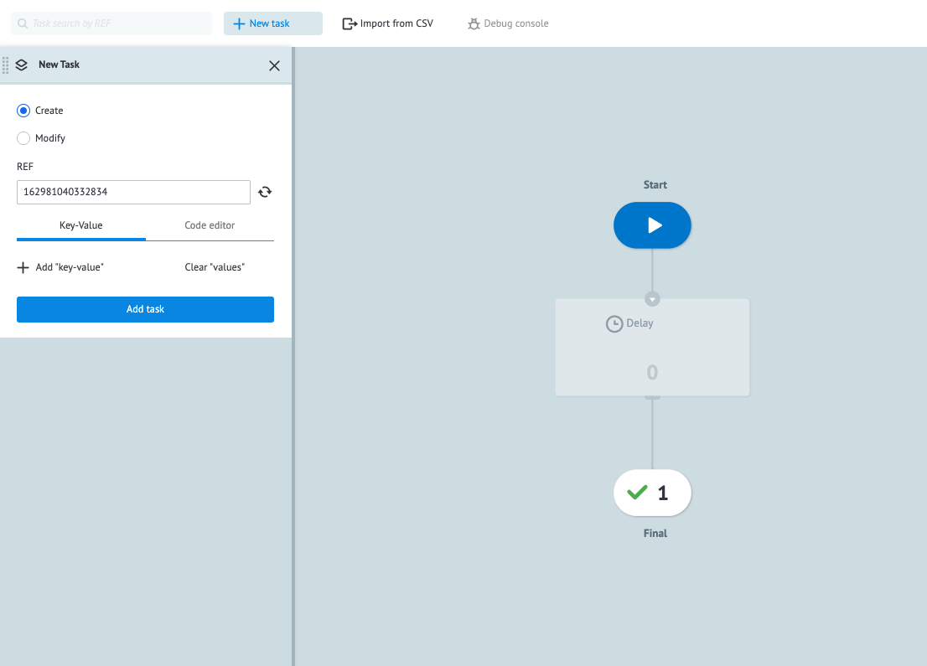
V. Mambu Process Orchestrator
MPO Structure: Running Tasks in View mode
Before running a task, you need to save and deploy the process by clicking Deploy in Edit mode. In order to run a task, select View mode in the menu tab.
Note: A process that has been initiated is called a task. A singe process may have many active tasks at the same time.
To send a new task through the process, click +New Task in the options below the main menu bar. The New Task pane will display on the left. In the pane you can new add parameters to be used in the task as key-value pairs. Then click Add task to run it.
Click Add task to run
Counters for the number of tasks that have reached each endpoint

Slide 19
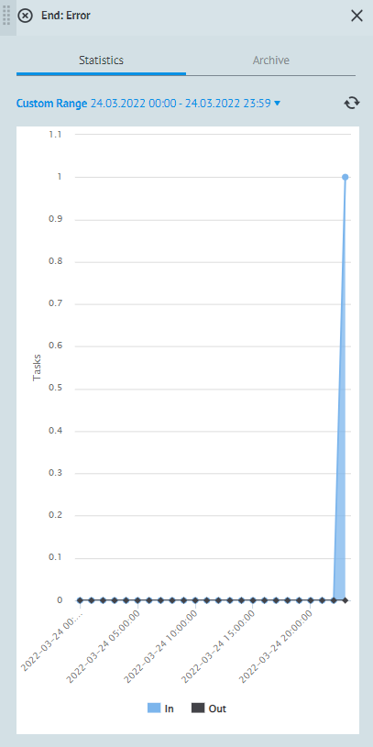
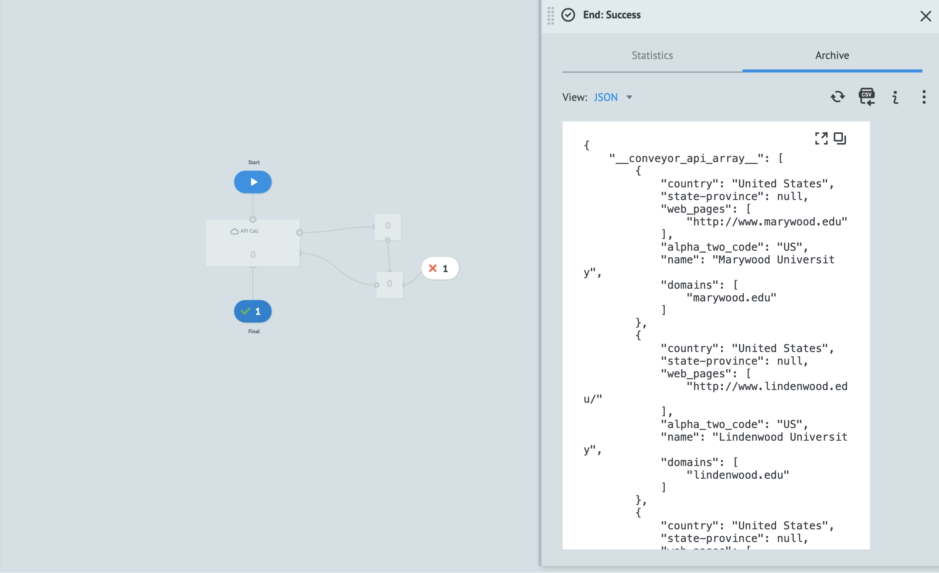
V. Mambu Process Orchestrator
MPO Structure: Running Tasks in View mode
In the Final nodes you will see counters for the number of tasks that have reached each endpoint. Additional information is available when you click any Final nodes. The information panel on the right that pops up contains Statistics about all the tasks that have been run and an Archive of responses and errors that the task has returned.
Note: Final nodes come in two types:
End: Success
End: Error nodes
Both store information about tasks that have ended at their endpoints.
number of times it ran unsuccessfully
Information Panel
View option: Statistics
View option: Achieve

Slide 20
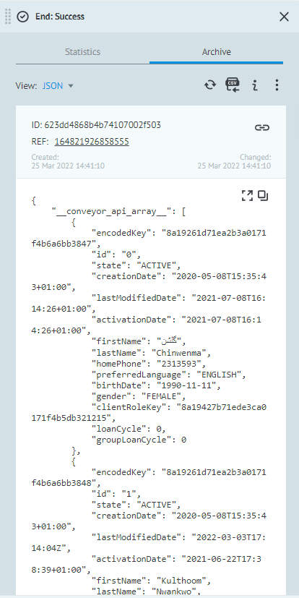
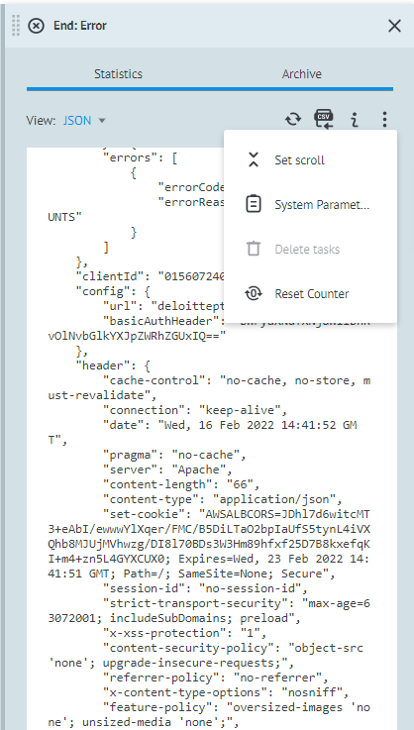
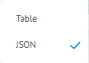
V. Mambu Process Orchestrator
MPO Structure: Running Tasks in View mode
Under the Archive tab you can export you can view responses and errors in JSON or as a table, which you can also export as a CSV. To reset the task counter for an endpoint, click the three-dot menu and select Reset Counter.
Task ID: Unique value in the entire system
View responses and errors in:
JSON or Table
Task Reference: Unique value in the current process
Changed: Date and time when the task
was changed
Create: Date and time when the task was created
Reset Counter
JSON object which contains current task parameters
Note: This image is an example of End: Success
Note: This image is an example of End: Error

Slide 21
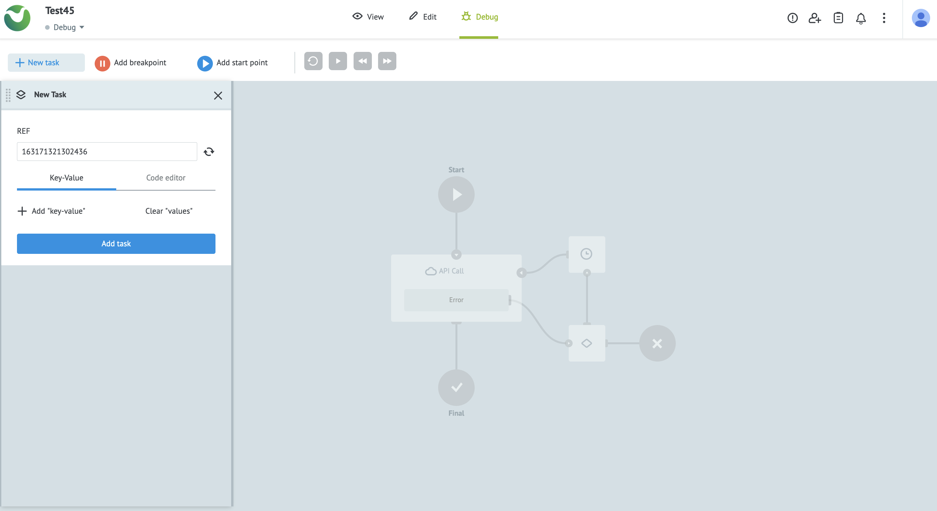
V. Mambu Process Orchestrator
MPO Structure: Debugging Processes in Debug Mode
Before debugging a process, it is recommended that you set the state of the process to Debug in the status menu dropdown in Edit mode. To start debugging go to Debug mode in the menu bar.
Debug mode

Slide 22
V. Mambu Process Orchestrator
MPO Structure: Debugging Processes in Debug Mode
On the left-hand side you will find the New Task panel, to start a new task, and in the sub-menu below the main menu bar you’ll find options to:
Add breakpoint: Change the end point of the process to isolate a section. To add a breakpoint drag Add breakpoint to where you want to pause the task.
Add start point: Change the start point of the process to isolate a section. To add a start, point drag Add start point to where you want to pause the task.
Repeat: Repeat running the task.
Start / Stop: Start or stop the task. This runs the task normally and not step-by-step as with Step back and Step forward.
Step back: Move the task backward by one node to execute it manually node-by-node.
Step forward: Move the task forward by one node to execute it manually node-by-node.
Add
breakpoint
Add
Start point
Repeat
Step forward
Start/
Stop
Step back

Slide 23
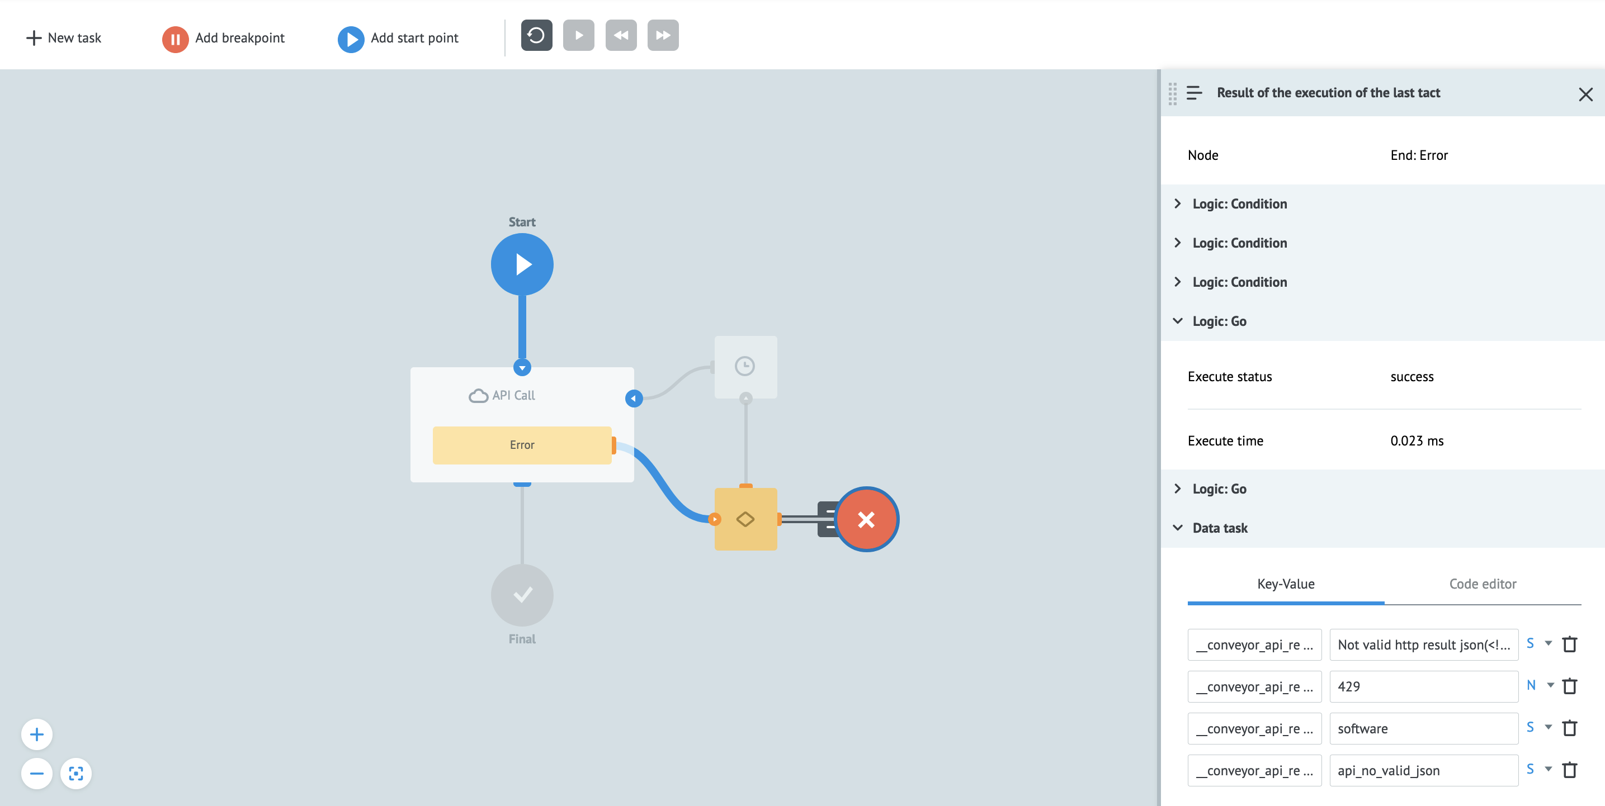
V. Mambu Process Orchestrator
MPO Structure: Debugging Processes in Debug Mode
When you run a task you’ll see an information box on the right-hand side, which contains parameter values at each step of the running task under Data task. If you use the Step back and Step forwards controls, you can also change parameter values under the Key-Value tab to fix or improve your task. To edit or view code you can click the Code editor tab.

Slide 24
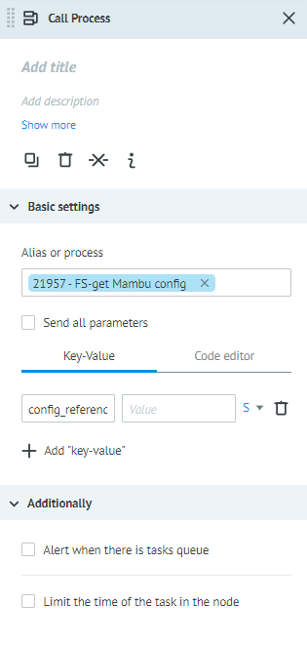
V. Mambu Process Orchestrator
MPO Structure: Call Process
Click on a node to open its settings. These may include a Basic Settings, Parameters and an Additionally section. The settings common to all nodes are at the top and include options to Add title and Add description. Below that, the options available are Copy node, Remove node, Remove links and Show node info.
Common Settings
Common Settings with detail
Add title
Add description
Copy node
Show more info
Remove links
Remove node

Slide 25
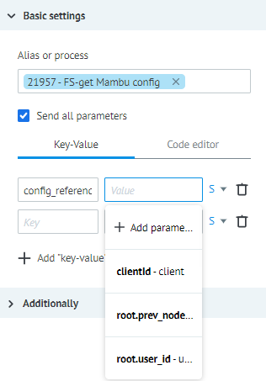
V. Mambu Process Orchestrator
MPO Structure: Parameters
Parameters (or variables) can be used in most nodes. You can declare your own parameters by selecting + Add “key-value” in the Parameters section of a node, clicking the Task parameters icon in top right (next to the bell icon) to set global parameters, or by using system parameters.
Basic Settings with detail
Type of values available: String, Number, Boolean, Array and Object
Basic
Settings
Delete parameter
Parameters
Add new parameter
Add new
“Key-value”
Created parameters

Slide 26
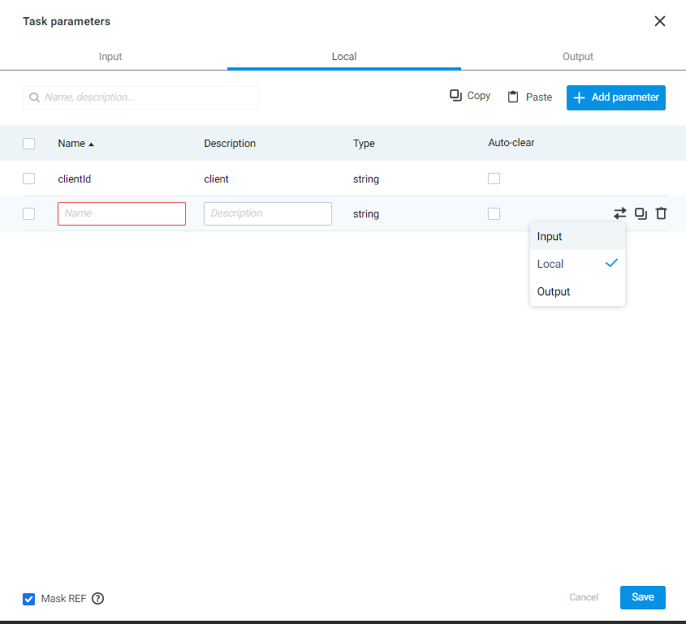
V. Mambu Process Orchestrator
MPO Structure: Create new parameter
For create a new parameter, click + Add parameter.

Slide 27
V. Mambu Process Orchestrator
MPO Structure: Additionally
The Additionally section contains extra settings, some of which are unique to that node type. Most nodes have two common settings that you can enable: Alert when there is tasks queue, which will notify you when tasks are stuck at this node, and Limit the time of the task in the node, which limits the execution time for that particular node.
Additionally, Settings with more detail
Additionally
Settings

Slide 28
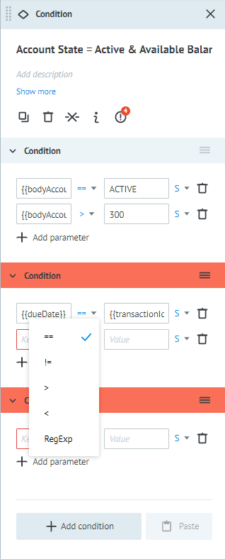
V. Mambu Process Orchestrator
MPO Structure: Simple Nodes
Simple nodes share many of the common settings described in Node Basics but differ in small ways depending on their function. The settings described below are settings unique to each node.
Set Parameter
Set a parameter or modify the value of a parameter within the task. In the Parameters section, declare new parameters using key-value pairs. You can use placeholders and functions to generate new values in the task or update existing ones.
Condition
The Condition node evaluates logic and directs the process according to this evaluation. In effect it recreates an IF statement and executes a path when a statement is fulfilled.
Area of parameters
Area of conditions
Add new parameter
Add new condition

Slide 29
V. Mambu Process Orchestrator
MPO Structure: Simple Nodes
Add a previously declared parameter in the key box. This will be the variable you are evaluating. You cannot compare a constant to a constant.
Select the logical operator you want to use: ==; !=; > or <. You may also Regular Expression to match patterns using the RegExp option.
Enter the value to compare the parameter to in the Value box.
If you would like to add na additional AND (&&) conditions, where both statements need to be true for the desired path to be followed, select +Add parameter.
If you would like to add na OR conditional, so that if one or both conditions trigger the desired path, select +Add condition and ensure that both paths lead to the same place.
You may also add another condition if you would like another condiitonal that leads to another node.
Delete parameter
Data type
Logical Operators

Slide 30
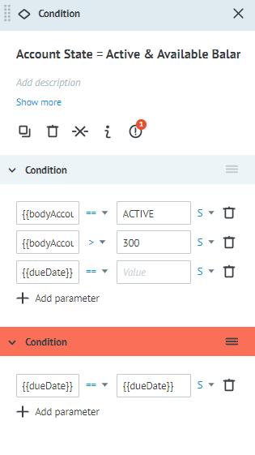
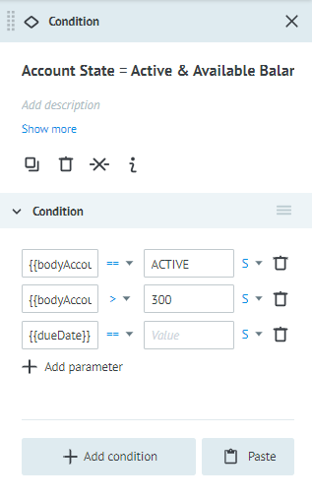
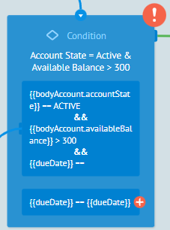
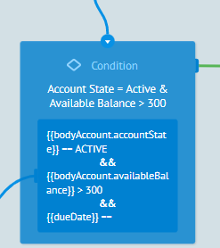
V. Mambu Process Orchestrator
MPO Structure: Simple Nodes
Note: Whenever you add a parameter to your condition. The process on the work area will be updated automatically.
If, add a new condition
Before adding a new condition
After adding a new condition

Slide 31
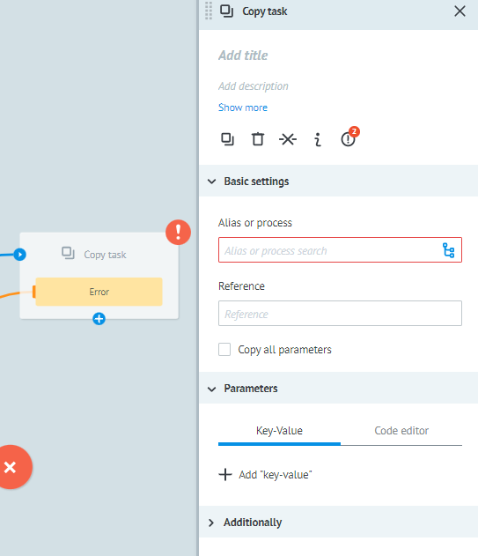
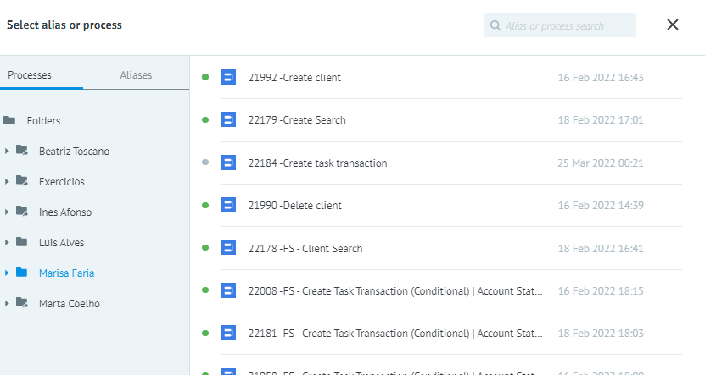
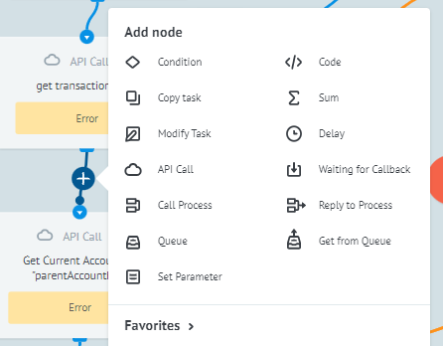

V. Mambu Process Orchestrator
MPO Structure: Simple Nodes
Copy Task
This node allows you to create a new task in a process or state diagram, using the values in the current task. You may also copy the entire task or just a subset of the available fields. In the settings box, select the process you want to copy in Basic Settings > Alias or process and add the reference of the task in the Reference input.

Slide 32
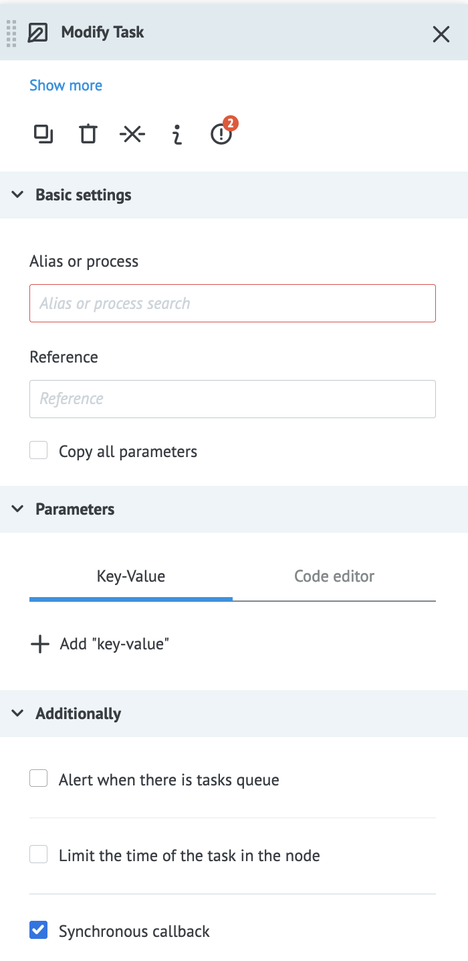
V. Mambu Process Orchestrator
MPO Structure: Simple Nodes
Modify Task
This node allows you to modify a separate task. The task being modified needs to have a Waiting for Callback node.
In the settings box select the process you want to modify in Basic Settings > Alias or process and add the reference of the task in the Reference input. To set new parameters go to the Parameters section and add new values. This will overwrite any old parameters that the process had or create new ones.
The task to be modified can be in any process or state diagram that has a Waiting for Callback or Set State node and it needs to be specified by the reference ID.
The Synchronous callback option in the Additionally section allows you to detect when you are attempting to modify a task that is currently being modified. Enabling this option makes this node return an error when multiple modifications are being made to the same task at the same time.

Slide 33
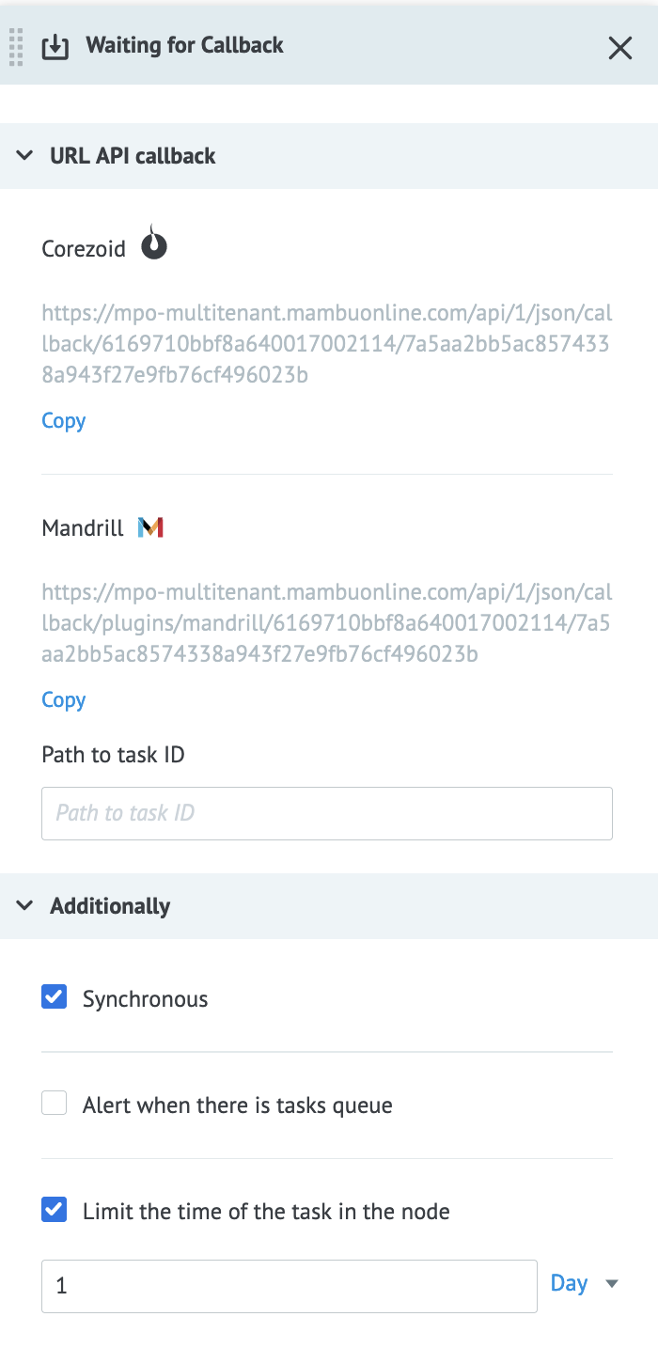
V. Mambu Process Orchestrator
MPO Structure: Simple Nodes
Waiting for Callback
Wait for a reply from a request made to an external system. This node freezes the task while waiting for a response and is a required component when using the Modify Task node. Your callback should be sent to the Corezoid URL shown in the node settings tab. Use URL API callback > Corezoid > Copy to copy this URL to your clipboard.
You can set the wait time for the node by changing the value under Additionally > Limit the time of the task in the node.

Slide 34
V. Mambu Process Orchestrator
MPO Structure: Simple Nodes
Delay
This node delays a task at a specific point. The time interval for the delay can be set in seconds, minutes, hours or days and the delay cannot be less than five seconds.
Enter the numerical value or a parameter in the input box below Limit the time of the task in the node and change the time scale in the dropdown next to the input box. If you use a parameter, it must contain a date and time in the unixtime format plus the delay to add to this time. You may use the $.unixtime() function to get the current time.
End
A node to end the process, which comes in two type: Error or Success. An End: Error node labels tasks that end with an error and End: Success nodes labels tasks that end successfully. Note that these nodes have no intrinsic meaning to the system and are used to label different outcomes.

Slide 35
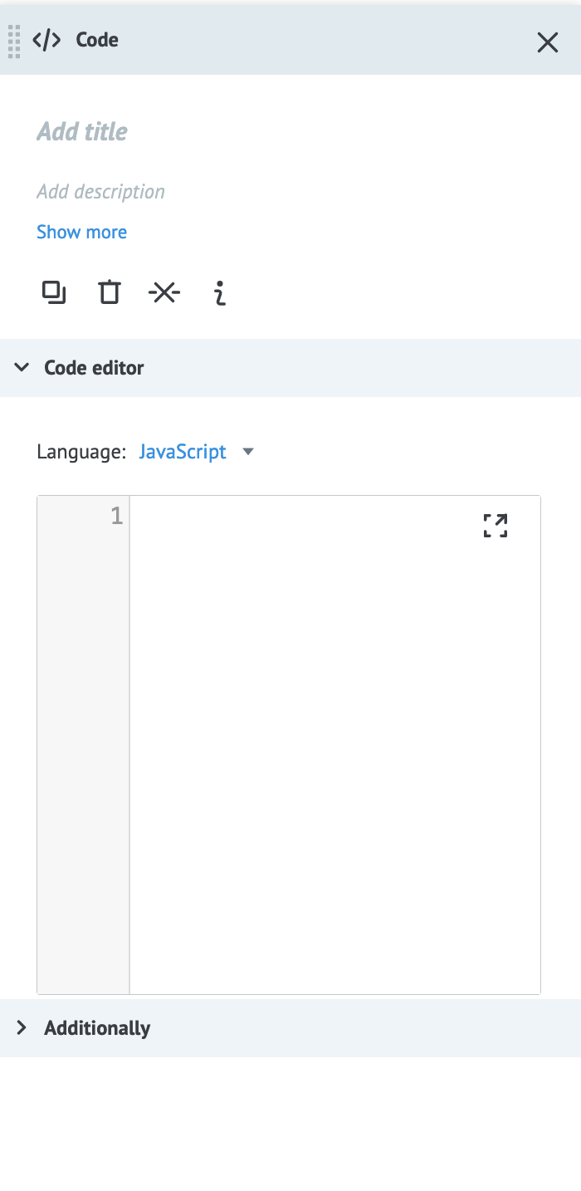
V. Mambu Process Orchestrator
MPO Structure: Additional Settings for complex
Most complex processes make use of the Code, API Calls, Call Process, Reply to Process, Queue, and Get from Queue nodes. Their basic settings are described in the Node Basics article and the information below only covers their unique settings.
Code
The Code node allows you to execute JavaScript or Erlang code within a node. It consists of a Code node, a Delay node and Condition node working together to run the code. The Delay node is used as a circuit breaker, to limit the time that your code can run, and the Condition node catches errors in your code.
We recommend working on your code in a code editor and pasting it into the node. The MPO UI offers only basic validation.

Slide 36
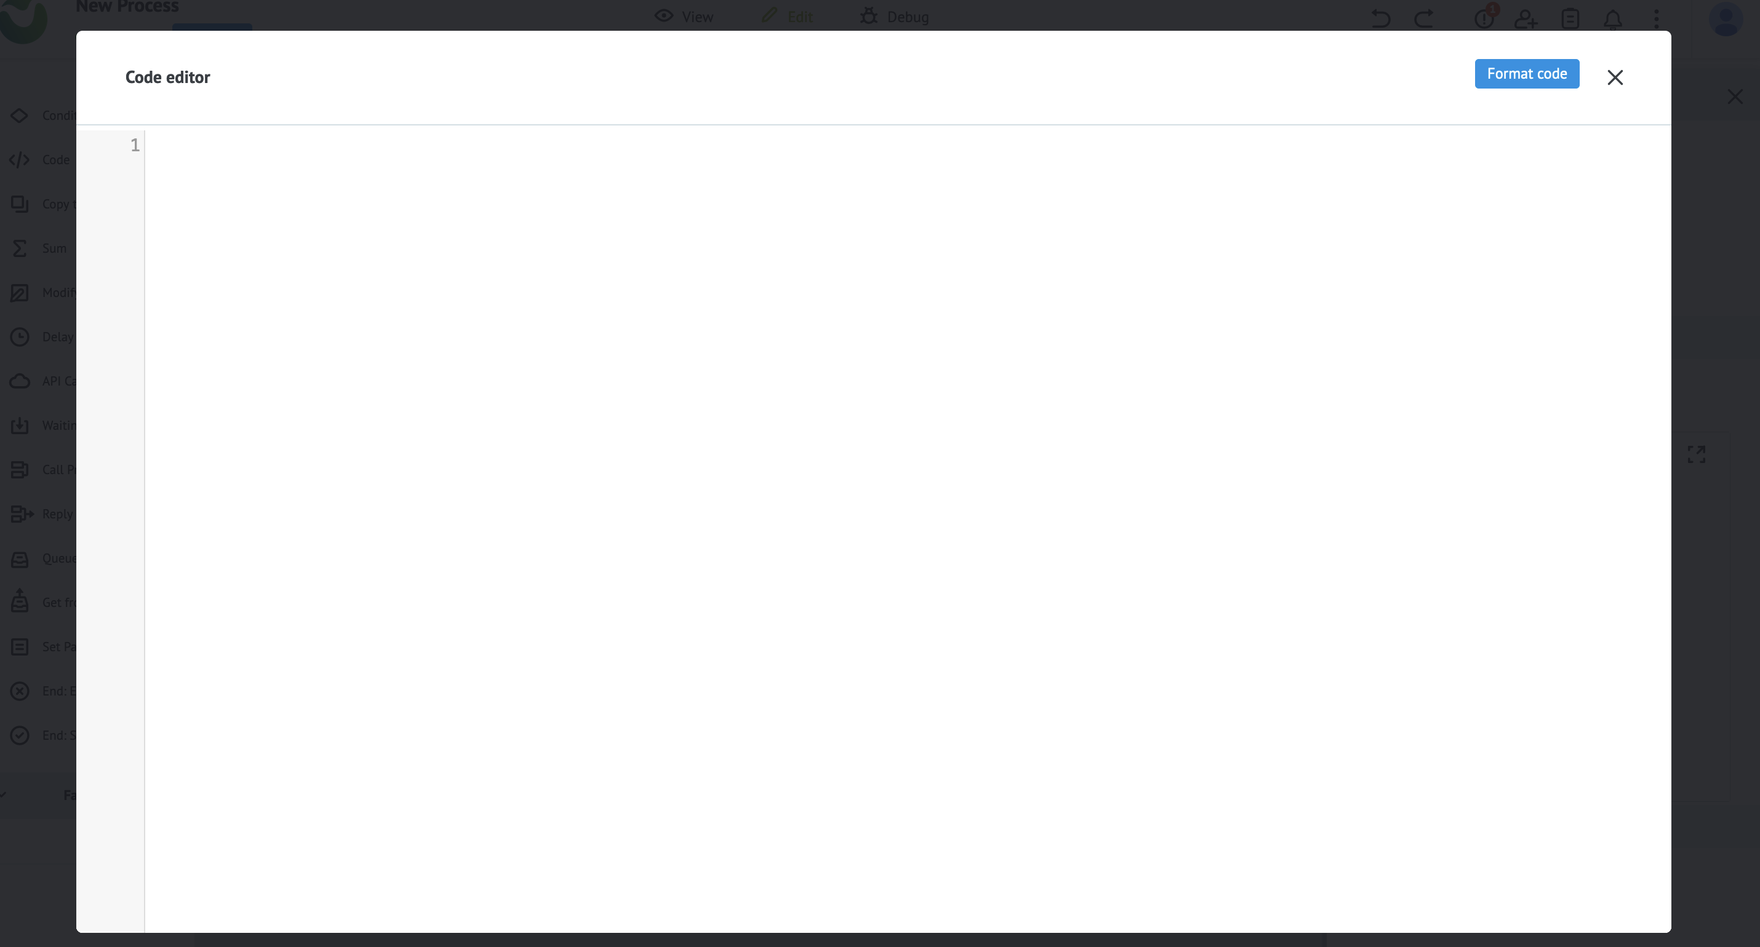
V. Mambu Process Orchestrator
MPO Structure: Additional Settings for complex
Enter your code into the window provided. You can expand the window by clicking the fullscreen icon in the corner of the code window.

Slide 37
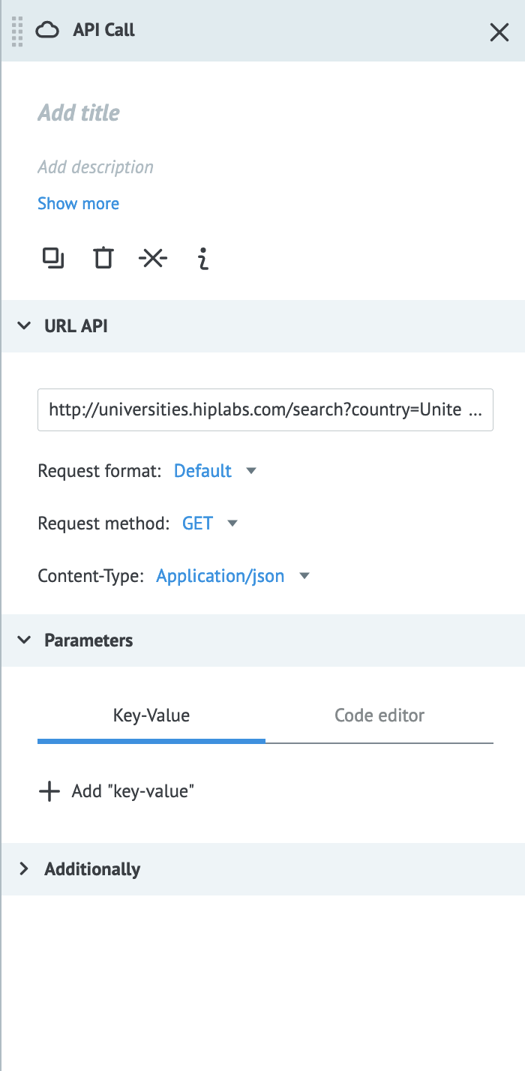
V. Mambu Process Orchestrator
MPO Structure: Additional Settings for complex
API CALL
This node allows you to make API calls to external services using JSON, XML or SOAP. A Delay and a Condition node are included automatically when you add an API Call node. These nodes handle errors that may arise when making calls. The Condition node determines the type of error returned and depending on the error, continues to either the Delay node to try again or ends the task with an error.
URL: The URL to retrieve data. You may use parameter values to include path parameters.
Additional Information:
Request format: The format of the request.
Request method: The action of the request.
Option | Value | Required
URL | URL beginning with https:// or http:// | yes
Request format | Default, Corezoid or Raw | yes
Request method | GET, POST, PUT, DELETE, HEAD or PATCH | yes
Content- Type | application/json, application/x-www-form-urlencoded, application/xml, text/xml, or application/soap+xml | yes
Content- Type: Defines what data format is being transferred in the request.

Slide 38
V. Mambu Process Orchestrator
MPO Structure: Additional Settings for complex
API CALL
Parameters
You can use parameters to declare the body of the API request or use them as path parameters in the request URL.
Parameters

Slide 39
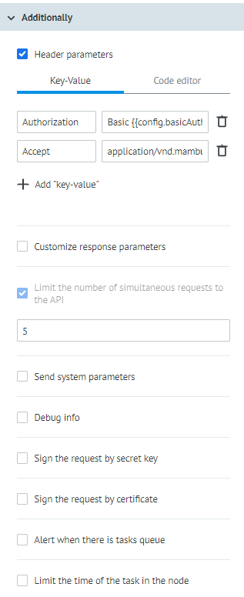
V. Mambu Process Orchestrator
MPO Structure: Additional Settings for complex
API CALL
Additional Settings
There are further options in the Additionally section, where you can:
Set header parameters using key-value pairs.
Customize the response parameter.
Limit the number of simultaneous requests to the API.
Use system parameters as path parameters in the request URL by enabling Send system parameters.
Sign the request by secret key.
Sign the request with a certificate.
Additional Settings

Slide 40
V. Mambu Process Orchestrator
MPO Structure: Additional Settings for complex
Call Process
The Call Process node makes a synchronous call to another process to upload a task and waits for a response from that process, which will use the Reply to Process node to send back a response. To specify the process that you want to call, you must add either the Process ID or the Alias in Basic Settings > Alias or process. This will upload a new task to that process.
To send the current processes parameters to the called process, select Send all parameters. You can also declare parameters to send at this stage by clicking + Add “Key-value” or adding a JSON object in the Code editor.

Slide 41
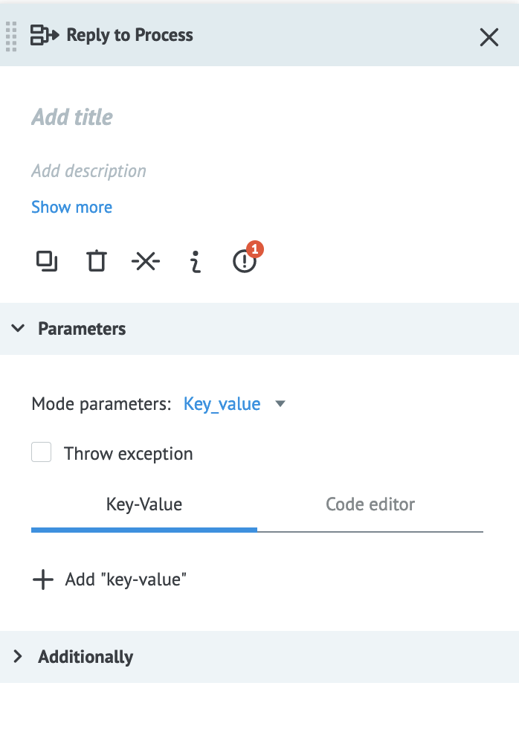
V. Mambu Process Orchestrator
MPO Structure: Additional Settings for complex
Reply to Process
In order to return a response, you need to add the Reply to Process node to the called process. You would add this node before every end node of the call process to ensure that a processed response is received by the calling process. In the Parameters section you define the parameters you want to return to the calling process.

Slide 42
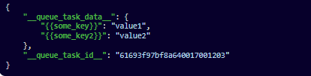
V. Mambu Process Orchestrator
MPO Structure: Additional Settings for complex
Queue
The Get from Queue node gets the task queue and parameters for another process. It is useful for getting data about tasks uploaded to other processes. In order to set it up, you need to add a Queue node to the process you want to get data from and a Get from Queue node to the process receiving the data. Placing the Queue node after the Start node allows you to register all the tasks uploaded to the process. The task queue is stored in the node and sends data when called by a Get from Queue node in another process.
Get from Queue
The Get from Queue node fetches data from a Queue node in another process. To set up the node you need to specify the Alias or process and the Queue node in the corresponding process in the Node input.
The returned object looks like this:
The "__queue_task_data__" object contains all the tasks parameters from the Queue node and the value of the "__queue_task_id__" key is the task ID.

Slide 43
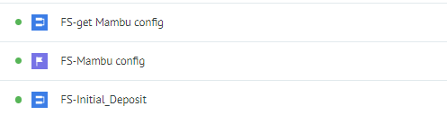
V. Mambu Process Orchestrator
MPO Process Configuration
The Mambu base configuration process consists of 3 dependent processes.
1. FS - Mambu config
2. FS- Fill all values inside and run this setup process
3. FS - get Mambu config
Note: The processes presented above must be executed in the same order.

Slide 44
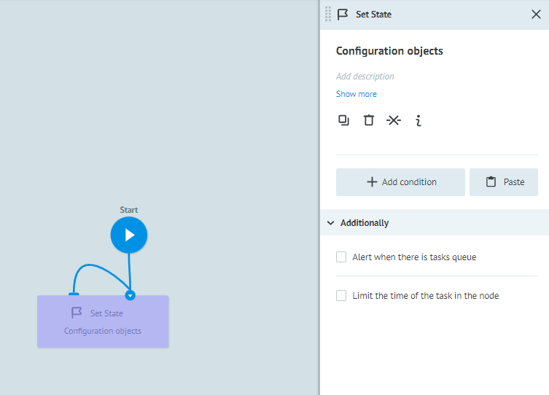
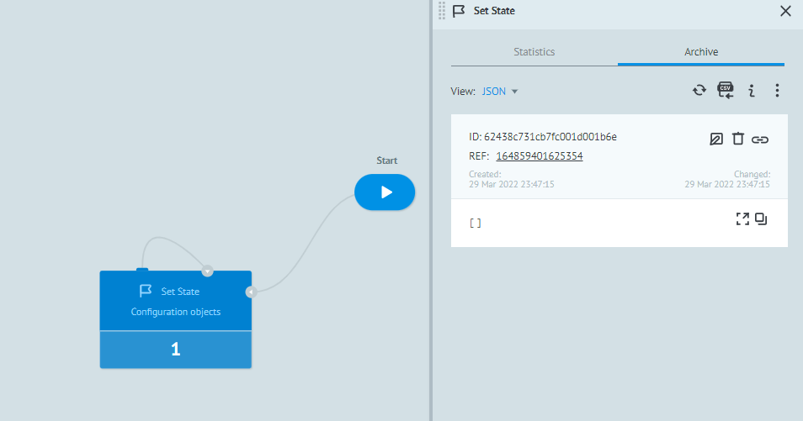
V. Mambu Process Orchestrator
MPO Process Configuration: FS – Mambu config
The first process to be configured is FS - Mambu config. In this first process, the user will only have to click on the view mode button and then select +New task and a window will appear on the left side called New Task. Click the Add task button to run the process. When selecting the Set State configuration box, an empty output is displayed.
The output is empty
Before running
After running

Slide 45
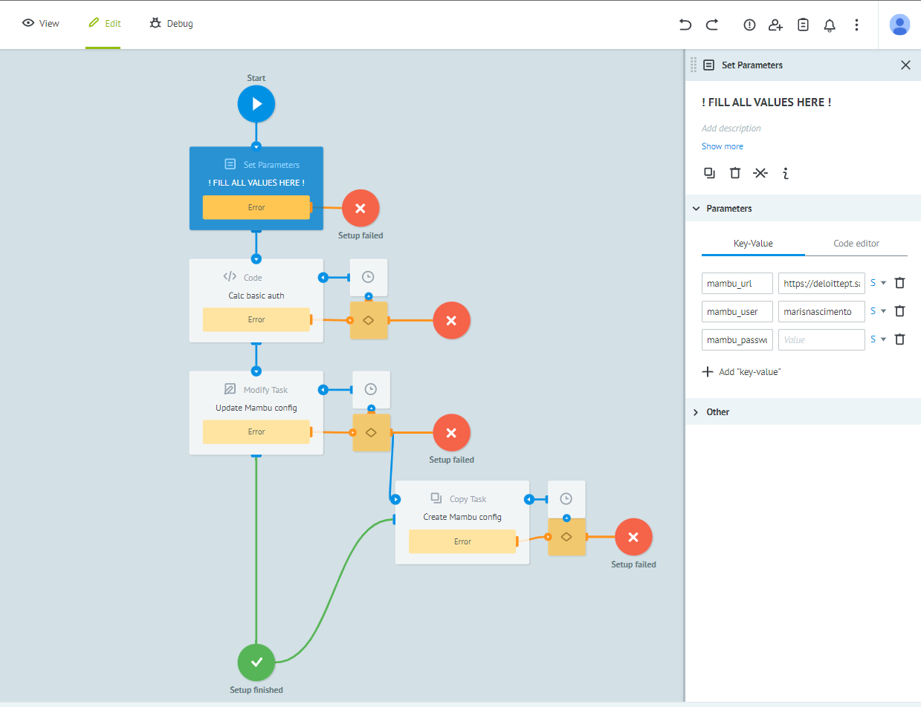
V. Mambu Process Orchestrator
MPO Process Configuration: FS- Fill all values inside and run this setup process
In this process, when selecting the Set Parameters box, the configuration details are presented.
In the parameters section, enter the following parameters:
mambu_url = https://deloittept.sandbox.mambu.com
mambu_user = user mambu
mambu_password = mambu password
After entering the values, click the View button and then
select +New task and a window will appear on the left
side called New Task. Click the Add task button to run
the process.
Box dedicated
of Parameters
Area of Parameters

Slide 46
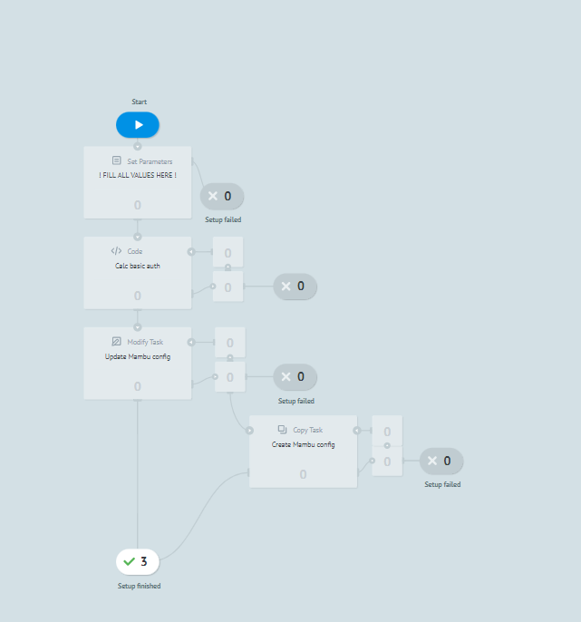
V. Mambu Process Orchestrator
MPO Process Configuration: FS- Fill all values inside and run this setup process
The workflow will be displayed in preview mode. In this mode, it can be verified that the process was executed successfully.
1
The process was executed one once with success.

Slide 47
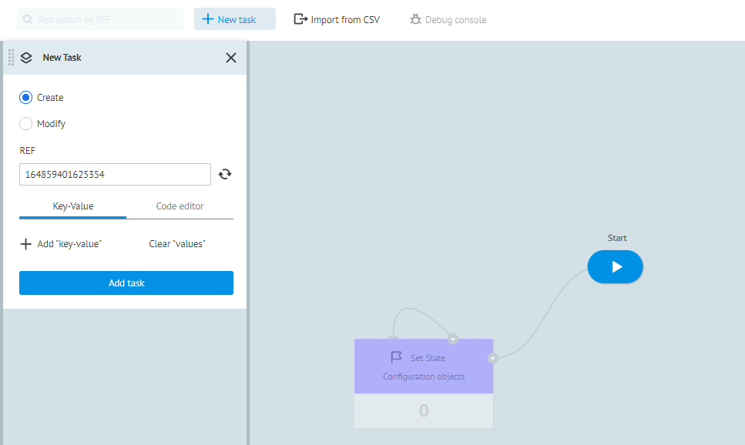
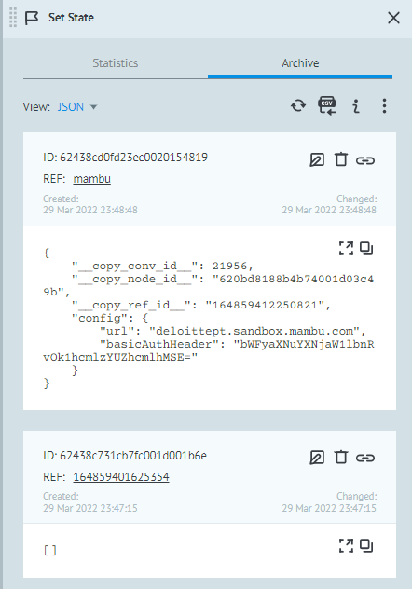
V. Mambu Process Orchestrator
MPO Process Configuration: FS – Mambu config
After running the process: DA- Fill all values inside and run this setup process, go back to the first process: FS - Mambu config and run it again.
In the case of this second execution, when selecting +New task a window will appear on the left side called New Task. Click the Add task button to run the process.
In the case of the second execution of this process, we can conclude that it is presenting an output with the connection details created.
Output of 2º execution
Output of 1º execution

Slide 48
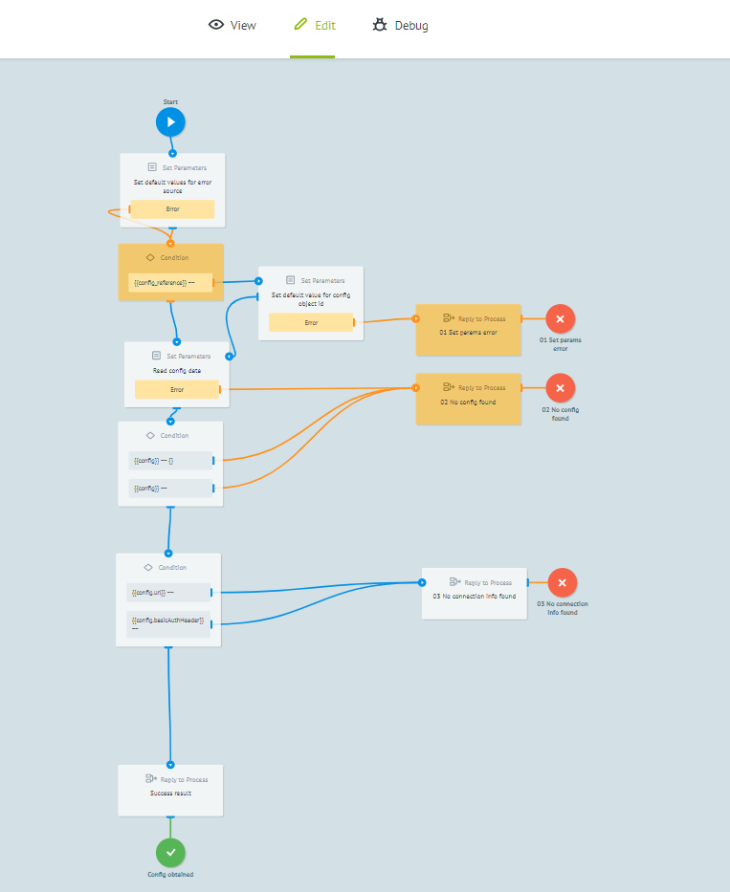

V. Mambu Process Orchestrator
MPO Process Configuration: FS - get Mambu config
The next step is to run the FS process - get Mambu config. Select the mode view, and when selecting +New task a window will appear on the left side called New Task. Click the Add task button to run the process.
Output

